Slide 1

Unit 4: Lesson 1 The Marmite effect

Slide 2
Task 1: Look at the sculpture and read the text below. How does it make you feel?
Task 2: Which words have a positive and which have a negative meaning? Which can have both?
Task 3: Which words from task 2 would you use to describe the statue?
Positive | Negative | Both
majestic imaginative cool interesting bold futuristic amazing inspiring | disgusting hideous scary confusing controversial ugly weird | simple minimal shocking extravagant dramatic subtle

Slide 3
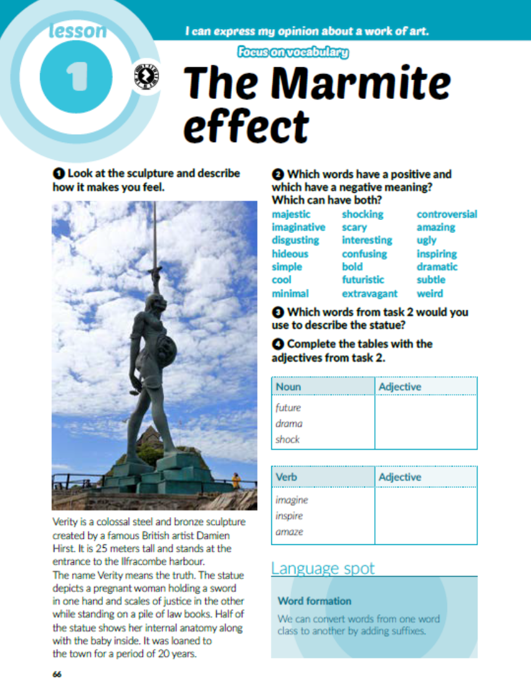
Task 4: Complete the tables with the adjectives from task 2.
futuristic
dramatic
shocking
imaginative
inspiring
amazing

Slide 4
Task 5: Listen to the radio show and match the sentences.
https://www.e-sfera.hr/dodatni-digitalni-sadrzaji/a86ab655-f32d-4212-b80e-101fe0b156b5/
2
1
3

Slide 5
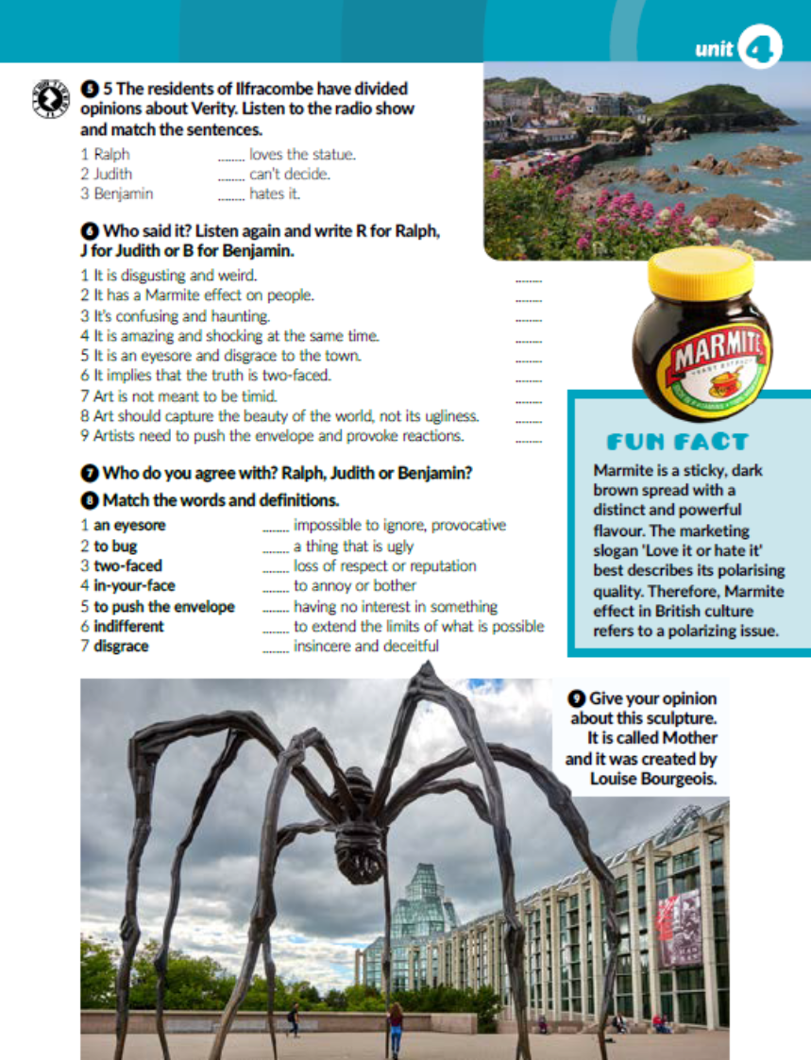
Listen again and write R for Ralph, J for Judith and B for Benjamin.
https://www.e-sfera.hr/dodatni-digitalni-sadrzaji/a86ab655-f32d-4212-b80e-101fe0b156b5/
B
J
R
R
B
R
J
B
J

Slide 6

Task 8: Match the words and definitions.
4
1
7
2
6
5
3

Slide 7

Task 9: Give your opinion about the sculpture in the picture.

Slide 8
workbook, page 67
Task 1: Sort out the words from the box.
drawing
painting
photography
sculpting
fiction
drama
poetry
prose
music
theatre
filmmaking
dance

Slide 9
Task 2: Complete the table with the correct words.
shock
imagine
inspiration
amazing
confuse
beauty
disgrace
spread
disgusting

Slide 10
imagination
Task 3: Use the words in brackets to form new words.
shock
amazing
inspiration
futuristic
disgusting
spread
confusion
creative

Slide 11
Task 4: Choose the correct answer.

Slide 13
Task 6: Read the description of the sculpture called Verity and correct the mistakes.
steel
British
25
harbour
truth
sword
law
anatomy
20

Slide 14
Task 7: Complete the sentences with the words from the box.
disgrace
bug
in-your-face
push the envelope
two-faced
spread
indifferent
monstruous

Slide 15

PLAY AND LEARN!
https://www.e-sfera.hr/dodatni-digitalni-sadrzaji/a86ab655-f32d-4212-b80e-101fe0b156b5/

